Slide 1
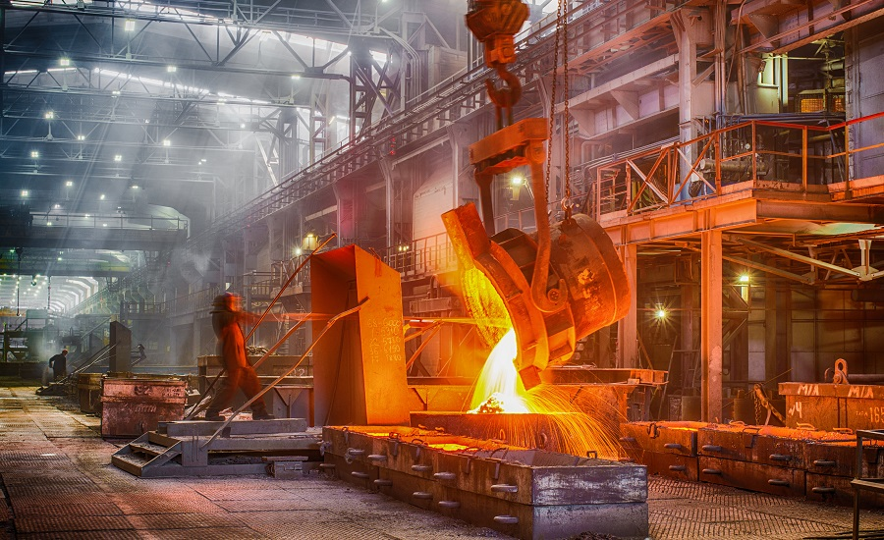

Slide 2
OUR STRENGTH
Partners involvement in all departments
Qualified partners for each department
MANAGEMENT TEAM :
MR. ISHWAR PATEL (B. Com.) FINANCE, PURCHASE, MARKETING, ACCOUNTS & PURCHASE
MR. NILESH PATEL (Be. Prod.) MACHINE SHOP IN CHARGE
MR. ASH ISH PATEL (Be. Prod.) DEVELOPMENT AND MOLDING
MR. HIREN PATEL (B.Sc.) QUALITY, PRODUCTION
MR. JAYANTI PATEL (H. S. C.) PLANT DEVELOPMENT

Slide 3
OUR STRENGTH
On time delivery
and quality products
at competitive rates

Slide 4
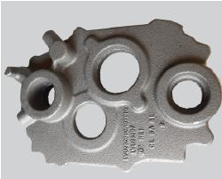
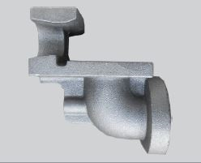
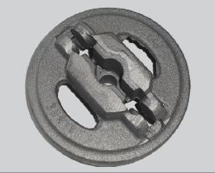
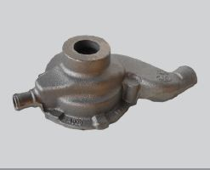
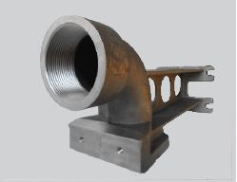
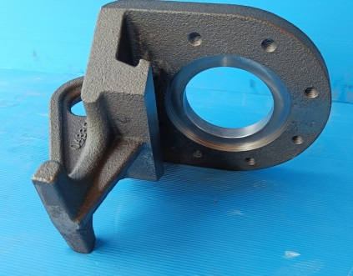
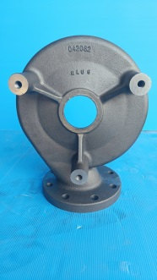
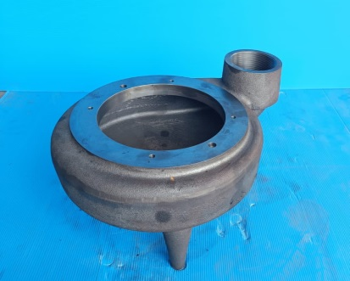
OUR STRENGTH
Speciality in smaller castings
weight ranging from 2 kg to 25 kg
Capacity up to 80kg casting
Batch quantity orders accepted

Slide 5
OUR INFRASTRUCTURE
Two molding lines, Pneumatic and Hydraulic with two different box sizes :
20"X10" and 24"X28"

Slide 6
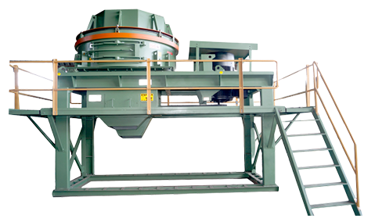
OUR INFRASTRUCTURE
Fully atomized
sand plant

Slide 7
OUR INFRASTRUCTURE
Fully equipped Metallurgy and Sand Labs for proper process control

Slide 8
OUR INFRASTRUCTURE
In-house all facilities of
Core Shop
Fettling Shop
Paint Booth
Pattern Shop
Machine Shop

Slide 9
OUR INFRASTRUCTURE
Induction furnace with most
advanced IGBT panel having energy monitoring system and highly analytical automation feature

Slide 10
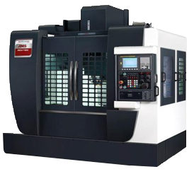
OUR INFRASTRUCTURE
Advanced CNC and VMC Turning Centres with pallet changer & 4th Axis

Slide 11
QUALITY
Fully equipped inspection facilities for inspection of machined parts

Slide 12
OUR TEAM
Skilled workers and Trained Supervisor with highest percentage of retention

Slide 13
Direct Export to US

Slide 14
Presence in Agriculture sector, Pump sector, and Machinery parts

Slide 15
OUR CUSTOMERS
Customer feedback: No need to take follow up for schedule delivery planning
A customer never visits our works for casting follow up

Slide 16
OUR CUSTOMERS
Present approved foundry for John Deere, Manugraph, Kirloskar, Hitachi and serving many MNC companies

Slide 17
CONTACT US
890/1&2, Behind Menon Pistons Ltd., Nagaon, Kolhapur, (Maharashtra) INDIA. - 416 122
Ph. No.: +91 - 230 - 2468881
E-mail: ravientkop@gmail.com
E-mail: info@ravientkop.co.in
Website: www.ravientkop.co.in

