Slide 1
RIDHI SIDHI
A Wear Resistance Solution Company
We Specialize In Abrasion Resistant High Chromium, Ni Hard, Mn Steel & Alloy Steel Casting

Slide 2
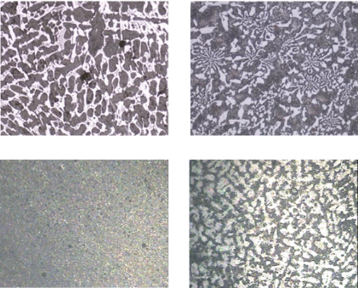
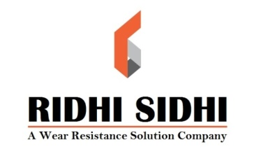
www.wearpartsindia.com
About Us
METALS MANUFACTURED -
RIDHI SIDHI is specialized in casting
wear parts and produces parts in
below metals.
* Ni-hard
* High chromium
* Mn Steel
* Alloy Steel
* Plain carbon Steel

Slide 3
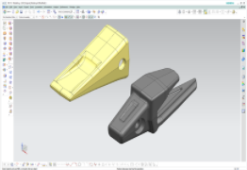
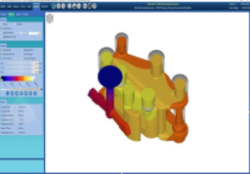
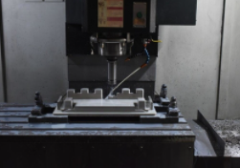
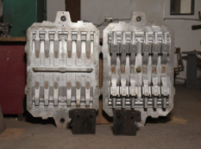
www.wearpartsindia.com
Development
The starting point of everything we make. All pattern tooling metallic & non- metallic are VMC cut.
UNIGRAPHICS AUTOCAST X1
SOLID MODELLING SIMULATION
VMC CUTTING PATTERN & CORE BOX

Slide 4
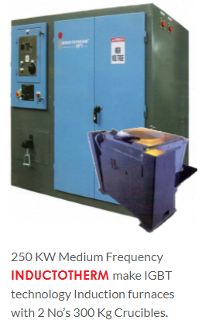
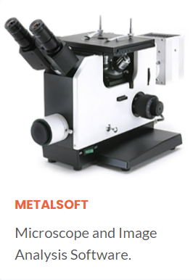
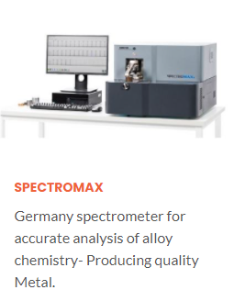
Production & Quality Infrastructure
www.wearpartsindia.com
RIDHI SIDHI is committed highest engineering performance in casting manufacturing. The in-house casting production technologies ensure the end product is manufactured to the Superior quality.

Slide 5
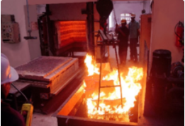
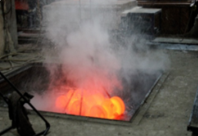
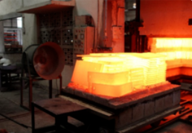
In-house Heat Treatment Shop
www.wearpartsindia.com
Atomized Co2 sand Batch Mixers – For better quality moulding sand with reclamation Plant for effective use of burnt sand.
25 Ton Sand hoppers for storage of fresh and reclaimed sand.
Compaction Table for easy moulding with roller conveyors.
Core & Mould Oven –For removal of moisture.
125 CFM Screw Air compressor with piping running all around the factory.
Shot Blasting & full fledge Fettling shop.
Rockwell/ Brinell / Poldy Hardness testing facilities. Inspection Room with all dimensional Inspection instruments.
In House Heat Treatment Shop With PLC Control Electric Heat Treatment Furnaces and Effective Cooling and Agitating Systems .

Slide 6
Industries Served
www.wearpartsindia.com
Construction Equipment Industry
Agricultural Equipment Industry
Pump Industry
Coal & Energy Industry
Cement & Steel Industry
Automobile & General Engineering Industry

Slide 7
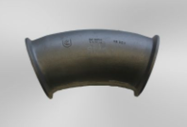
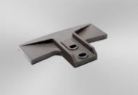
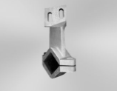
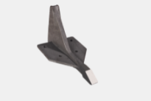
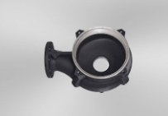
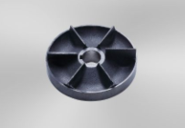
www.wearpartsindia.com
Products Few Parts Manufactured By Us

