Slide 1
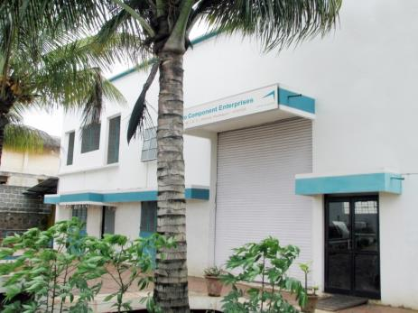
Auto Component Enterprises
Visit us : www.autocomponent.co.in

Slide 2
INTRODUCTION
● Auto Component Enterprises was established in 1995 by two
brothers, Hemu and Reghu Menon
● We have experience of 25+ years in Manufacturing of precision
engineering components and sub-assemblies
● We have core expertise in manufacturing mass production
components for the Automotive Industry and small batch
quantities for general engineering Industry
● Lately, the partner’s children have also joined the business and
apart from bringing with them new vigour and ease with the
latest technology, they also will provide much needed
continuity and focus for future growth.

Slide 3
VISION
To be the most customer friendly company in our core areas of competence, whereby we can provide precision engineering components to our customers at the best price with zero / minimal follow up, ensuring it saves them time and money, every time they deal with us.

Slide 4
STRENGTHS
Our Team
Some of our key employees have been with us for more than 15 years, experienced and skilled to a high degree in our operations, which helps us consistently maintain quality, control costs, and deliver in time.
Our company policies help us to retain the best talent and we can proudly say that our attrition rate is less than 1%, which helps us save time and money in training new employees.

Slide 5
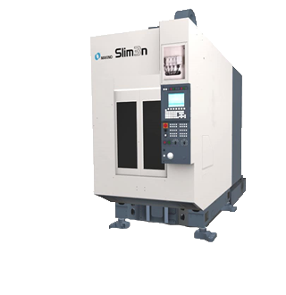
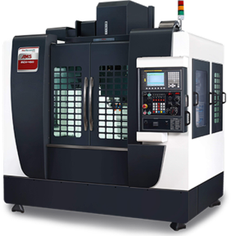
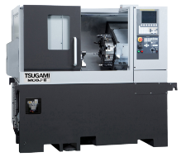
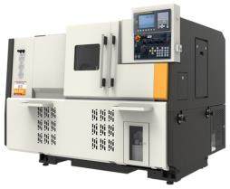
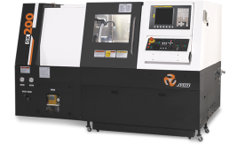
STRENGTHS
Infrastructure
We have a blend of state of the art Japanese and Indian Machines

Slide 6
STRENGTHS
Several of our Customers have been associated with us for more than 20 years due to our commitment towards quality and timely delivery at the best value.

Slide 7
STRENGTHS
We have a good knowledge base in designing, manufacturing Fixtures and SPMs which helps us in speedy and economical development of components.

Slide 8
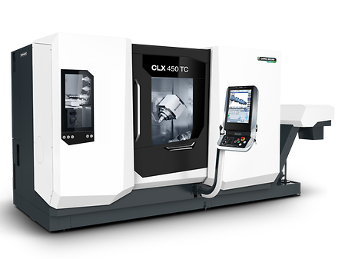
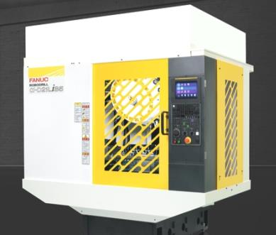
OUR FUTURE PLAN
In the near future we are planning to augment our capacity and
capability with DMG Moriseiki Mill Turn Center and Fanuc 5 Axis Machines
Fanuc 5 Axis VMC
DMG MORI Multitasking 5 Axis machine

Slide 9
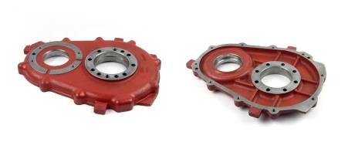
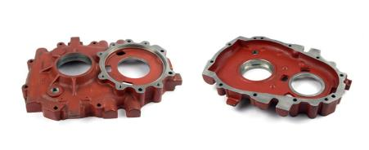
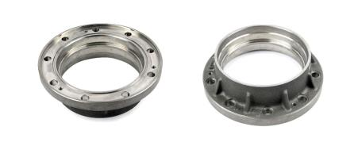
SOME OF OUR PRODUCTS
Gear Box Cover for Tractors
Gear Box Cover for Tractors
Gear Box Housing for Earth Moving Machines

Slide 10
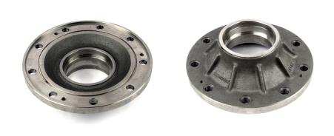
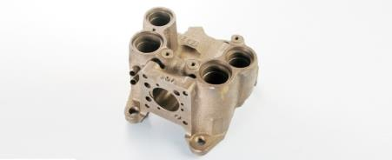
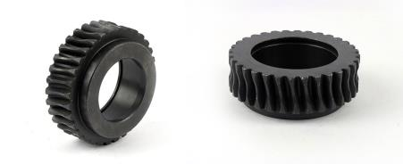
SOME OF OUR PRODUCTS
Gear Box Housing for Earth Moving Machines
Crank Case for Compressor
Worm Wheel for Printing Machines

Slide 11
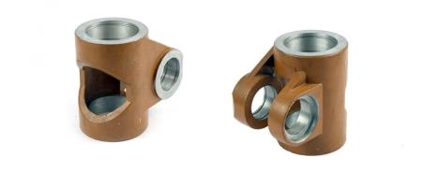
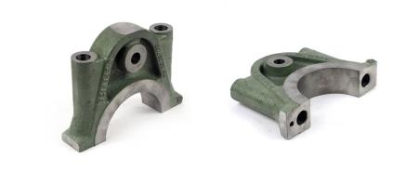
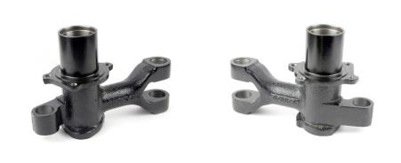
SOME OF OUR PRODUCTS
Gear Box Housing for Printing Machines
Bearing Cap for Gen sets
Steering Knuckle for Three Wheelers

Slide 12
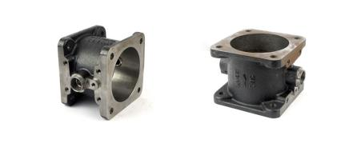
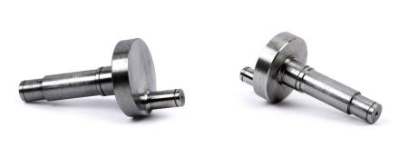
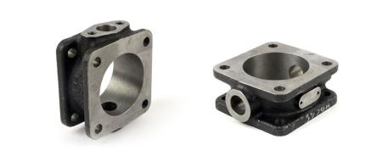
SOME OF OUR PRODUCTS
Cylinder for Pneumatic Ind.
Eccentric Shaft for Printing Machines
Cylinder for Pneumatic Ind.

Slide 13
OUR CLIENTELE

Slide 14
We are tier two suppliers for TVS Motors, TATA Motors, Kirloskar and Cummins.

Slide 15
Auto Component Enterprises
An ISO 9001:2015 Company
Plot No. G-58, M.I.D.C. Shiroli,
Kolhapur – 416 122, Maharashtra, India.
Contact Person : Rohit Menon
Cell : +91 – 9028645050
Email :
info@autocomponent.co.in
autocomponentkolhapur@gmail.com

